Slide 1
CUSTOMER SEGMENTATION ANALYSIS FOR IMPROVING SALES USING CLUSTERING

Slide 2
REVIEW -1

Slide 3
TOPICS
INTRODUCTION
ABSTRACT
LITERATURE SURVEY
EXSISTING SYSTEM
DISADVANTAGES OF EXSISTING SYTEM
__________________________
PROPOSED SYSTEM
_________________________
ADVANTAGES OF PROPOSED SYSTEM

Slide 4
INTRODUCTION

Slide 5
INTRODUCTION
Effective body language enhances your message, making it more i Customer segmentation is the practice of dividing a company’s customers into groups that reflect similarity among customers in each group.
The goal of segmenting customers is to decide how to relate to customers in each segment in order to maximize the value of each customer to the business.
Customer segmentation has the potential to allow marketers to address each customer in the most effective way.
Packages : numpy, pandas, seaborn and matplotlib
Tools such as jupyter notebook to analyze and segment each individual customer.
It is based on four important attribute i.e. ‘age’, ‘gender’, ‘income’, and ‘spending score’.
5

Slide 6
ABSTRACT

Slide 7
ABSTRACT
Customer segmentation is useful in understanding what demographic and psychographic sub-population there are within your customers in a business case.
By understanding this, we can better understand how to market and serve them. The segmentation is based on customers having similar ‘needs’(so that a single whole product can satisfy them) and ‘buying characteristics’(responses to messaging, marketing channels, and sales channels, that a single go- to-market approach can be used to sell to them competitively and economically).
In this project we will explore a data set on customers to try to see if there are any discernible segments and patterns.
The goal of segmenting customers is to decide how to relate to customers in each segment in order to maximize the value of each customer to the business and to build a simple, easy to use and efficient interface.
The technologies that will be used in this project are packages such as numpy, panda, seaborn and matplotlib. Tools such as jupyter notebook will be used to analyze and segment each individual customer.
Segmentation will be based on three important attributes : ‘gender’, ‘income’ , ‘age’ and ‘spending score’

Slide 8
LITERATURE SURVEY

Slide 9
LITERATURE SURVEY
Research on attributes of shopping malls and hypermarkets in India is limited, with most studies focusing on foreign experiences in the US, UK, and European markets.
An earnest attempt has been made to delve into the relevant researches done on the theme, presented henceforth as
follows:
Brunner and Mason's 1968 study found that driving time is a significant factor in consumer shopping center preferences, with 15-minute driving points being the most significant dimension, as three-fourths of shoppers reside within this range. Other factors like population, purchasing power, and newspaper circulation also influence shopping habits.
Huff (1964 and 1966) concluded that the comparative size of the centers and the convenience of access were the primary characteristics that consumers sought when choosing a shopping center to visit

Slide 10
EXSISTING SYSTEM

Slide 11
EXSISTING SURVEY
All the existing systems use search based algorithms like fuzzy C-means, Gath Geva algorithm and Two step algorithm
With these algorithms it is difficult to gather and segment the data
The results are not really accurate as the clustering is not close enough to determine accurate centroids
These algorithms are complicated when compared to
K-means

Slide 12
DISADVANTAGES OF EXSISTING SYSTEM

Slide 13
DISADVANTAGES OF EXSISTING SYSTEM
Expensive Production
Promotion Problems
Stock and Storage Problems
Expensive Marketing
Other clustering algorithms tend to be harder to implement efficiently because it has more parameters
Also, compared to many algorithms available,k-means did not require any assumptions

Slide 14
PROPOSED SYSTEMS

Slide 15
PROPOSED SYSTEM
Develop the system to get easy visualization techniques
Increase the data set to accommodate many data points so that results will be more accurate
Segment the products directly according to the customer group
Use different methods to collect the customer data instead of physical forms

Slide 16
ADVANTAGES OF PROPOSED SYSTEM

Slide 17
ADVANTAGES OF PROPOSED SYSTEM
Saves time and money
Convenient
Extends to new markets
Helps in gaining trust of customers
Flexible
Can log on from anywhere

Slide 18
REVIEW-2

Slide 19
TOPICS
ARCHITECTURE
________________________________________
DATAFLOW DIAGRAM
________________________________________
ALGORITHM
_______________________________________
LIBRARIES AND ALGORITHM USED
________________________________________
MODULES IN THE SYSTEM

Slide 20
ARCHITECTURE

Slide 21
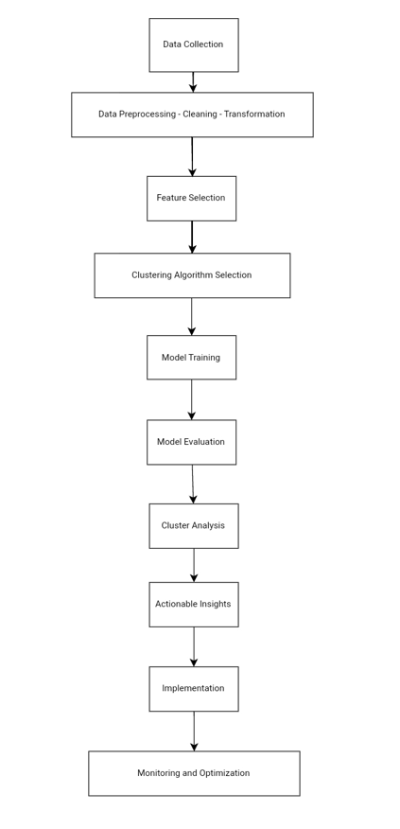
ARCHITECTURE
The machine learning architecture defines the various layers involved in the machine
learning cycle and involves the major steps being carried out in the transformation of raw data into training data sets capable for enabling the decision making of a system

Slide 22
DATAFLOW DIAGRAM

Slide 23
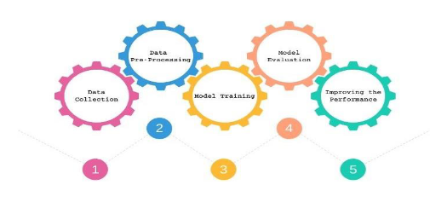
DATA FLOW DIAGRAM

Slide 24
ALGORITHM

Slide 25
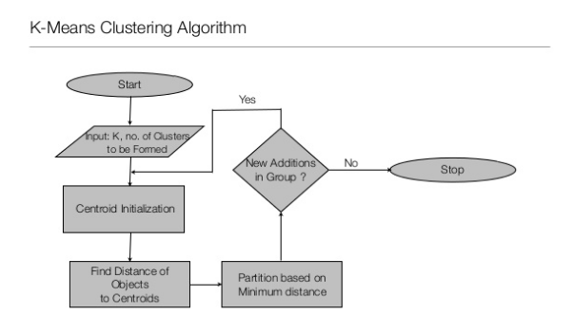
ALGORITHM
K-Means clustering :
Step 1: Select the number of clusters, k
Step 2: Select k points at random
Step 3: Make k clusters
Step 4: Compute New centroid of Each cluster
Step 5: Assess the quality of each cluster
Step 6: Repeat steps 3-5

Slide 26
LIBRARIES AND ALGORITHM USED
Libraries used:-
Numpy
Pandas
Seaborn
Matplotlib
Sklearn
Algorithm used:-
K-Means clustering :
The objective of k-means is to minimize the total sum of the squared distance of every point to its corresponding cluster centroid. Given a set of observations (x1, x2, …, xn), where each observation is a d-dimensional real vector, k-means clustering aims to partition the n observations into k (≤ n) sets S = {S1, S2, …, Sk} so as to minimize the within-cluster sum of squares where µi is the mean of points in Si.
The k-means algorithm is guaranteed to converge a local optimum.

Slide 27
MODULES IN THE SYSTEM:-
1)DATA ANALYSIS AND DATA PREPROCESSING
2)MODEL DEVELOPMENT
3)MODEL DEPLOYMENT
4)DATA VISUALIZATION

Slide 28
MODULE-1
Data Analysis and Data Preprocessing:
After collecting the required information from customers we
perform qualitative data analysis .
Steps of Data preprocessing like Data Cleaning , Data Transformation and Data reduction are performed where we remove null data or unwanted data
Segment each customer into their respective segments based on important attributes which are ‘age’, ‘gender’, ‘income’ and ‘spending score’
Import the necessary libraries i.e numpy, panda, seaborn and matplotlib

Slide 29
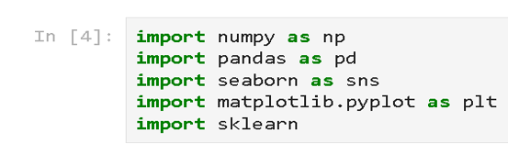
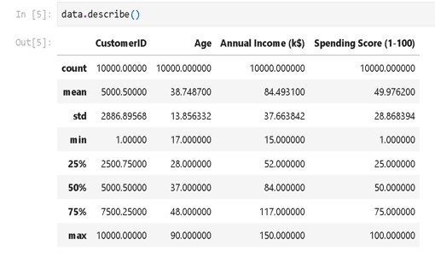
OUTPUT OF MODULE -1

Slide 30
MODULE-2
Model Development:
K-means clustering is used for segmentation of data into clusters
The elbow method is used to determine the number of clusters
Identify the sum of squared distances of samples to the nearest cluster centre.
Select the number of clusters

Slide 31
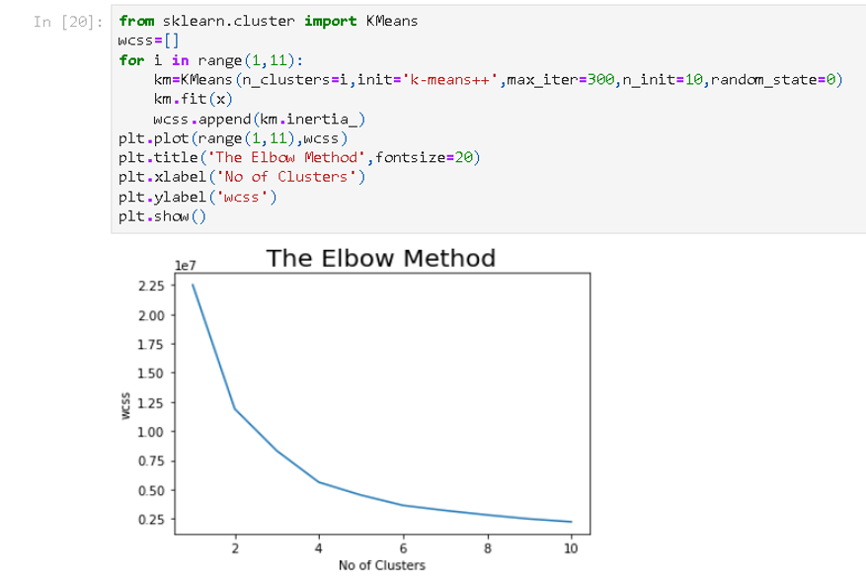
OUTPUT OF MODULE -2

Slide 32
MODULE-3
Model deployment :
Model deployment is the process of putting machine learning models into production.
The model analyzes the data.
We get the final results as the graphs emphasizing our target customers

Slide 33
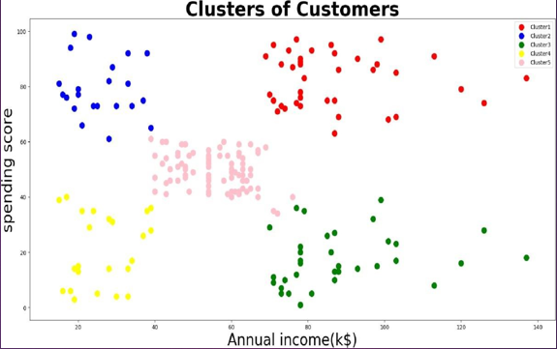
OUTPUT OF MODULE-3

Slide 34
MODULE-4
Data Visualisation :
Data visualization is a way to represent information graphically, highlighting patterns and trends in data and helping the reader to achieve quick insights.
Plot important information so that we can see the different values of our data and its behaviour.
Gender will only be used to make data separation so we can differentiate values for men and women.
We are plotting the histograms for each of the four attributes.

Slide 35
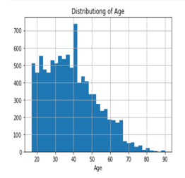
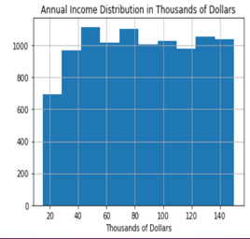
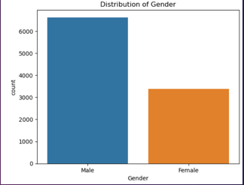
OUTPUT OF MODULE-4
Collecting the age samples from the dataset and plotting it in the graphs
Annual and spending score is collected and added into the dataset to train the model based on these parameters
Distribution of gender is an important parameter as many products are categorized based on gender

Slide 36
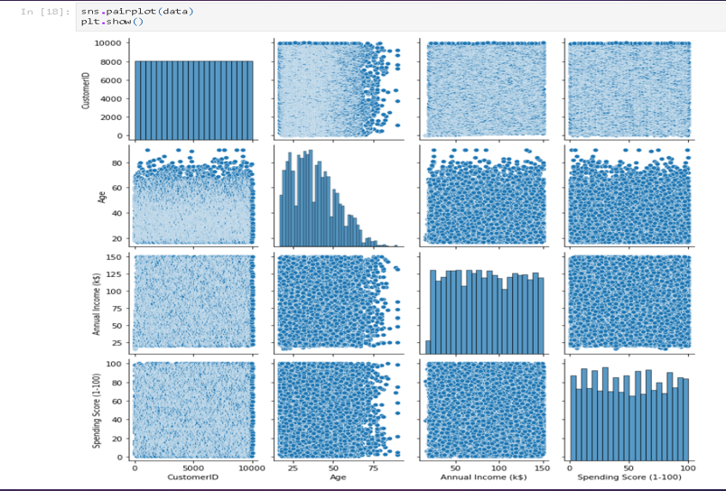

Slide 37
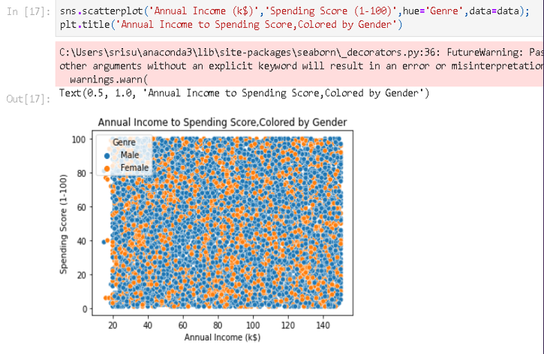

Slide 38
REVIEW-3

Slide 39
TOPICS
REVIEW-1
_______________________________
REVIEW-2
_______________________________
FUNCTIONING OF MODULES
_______________________________
EXECUTION
_______________________________

Slide 40
FUNCTIONING OF MODULES
1)DATA ANALYSIS AND DATA PREPROCESSING
2)MODEL DEVELOPMENT
3)MODEL DEPLOYMENT
4)DATA VISUALIZATION

Slide 41
DATA ANALYSIS AND DATA PREPROCESSING
Data analysis and data preprocessing are crucial steps in customer segmentation using clustering, as they help ensure that the data is clean, meaningful, and ready for analysis
1)Steps Data Analysis:
a)Exploratory Data Analysis (EDA):
b)Identifying Important Features:
c)Detecting Missing or Inconsistent Data:
2)Key Steps in Data Preprocessing for Clustering:
a)handling missing data
b)scaling and normalization
c)handling categorial data

Slide 42
MODEL DEVELOPMENT
Model deployment for customer segmentation using clustering with combined points refers to integrating multiple customer data attributes (e.g., demographics, purchasing behavior, online activity) into a unified dataset to derive meaningful clusters. These combined points help create a more comprehensive representation of customer profiles.
Here's how deployment is used effectively:
1)Customer Segmentation with Combined Data Points Feature Integration Dimensionality Reduction (if needed)Clustering
2)Deployment Workflow Feature Engineering Data Integration Weight Adjustment
3)Practical Applications in Customer Segmentation
4)Tools and Technologies

Slide 43
MODEL DEPLOYMENT
Module development involves systematically creating a framework that organizes customers into distinct groups based on shared characteristics or behaviors.
Here’s how the process is typically utilized:
1. Understanding Objectives
2. Data Preparation Module
3. Clustering Module
4. Customer Segmentation Insights Module

Slide 44
DATA VISUALIZATION
A data visualization module is a set of tools, libraries, or components designed to create visual representations of data. These visualizations help users understand complex data sets, identify patterns, and derive insights. In the context of customer segmentation analysis for improving sales using clustering, a data visualization module is essential for displaying the results of clustering algorithms and making the data comprehensible to stakeholders.
Key Components of a Data Visualization Module:
1)Data Input and Processing
2) Visualization Tools and Libraries
3) Types of Visualizations
4) Interactivity and User Interface
5) Reporting and Sharing

Slide 45
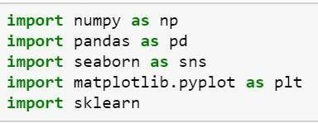
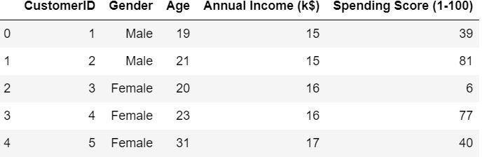
EXECUTION
Step 1:Import packages and libraries
Step 2: collect the dataset

Slide 46
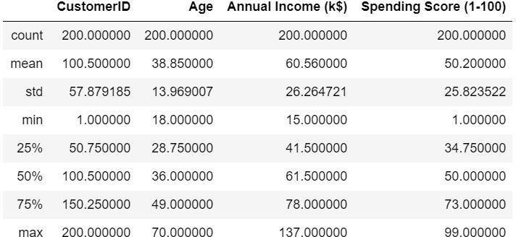
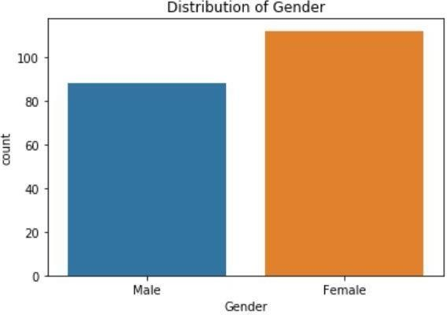
Step 3: Describe the dataset
Step 4: Plot the counter-plot

Slide 47
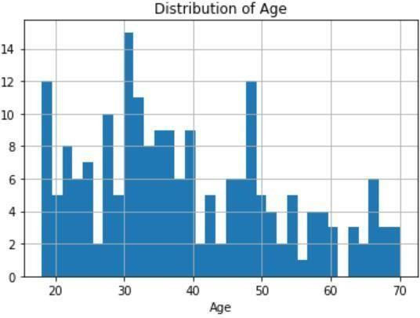
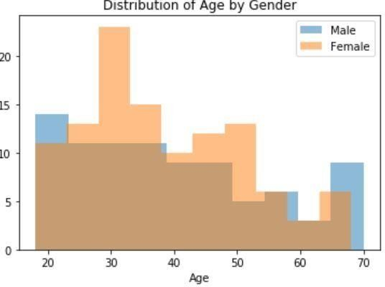
Step 5: Plotting Histograms

Slide 48
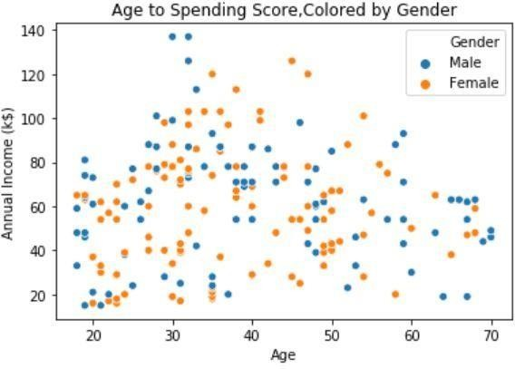
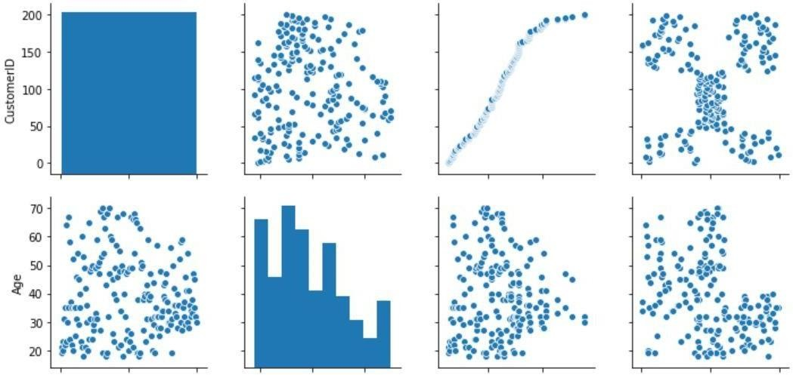
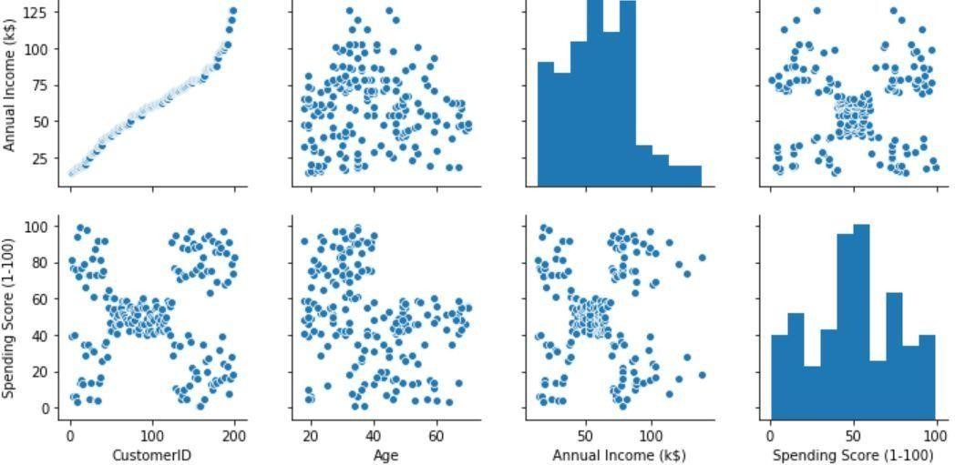
Step 7:Plotting pairplots
Step 6:Plotting Scatterplots

Slide 49
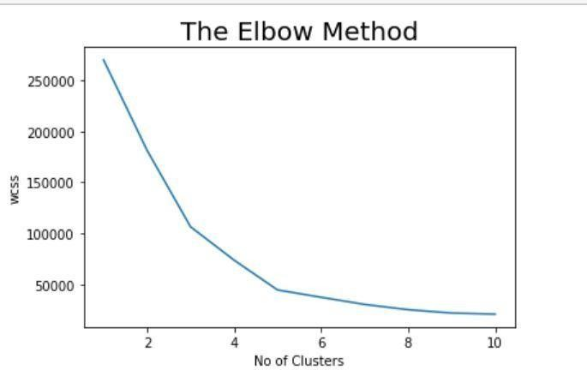

Step 8:Using Elbow curve method
Step 9:Using K-Means Clustering( Final output)

Slide 50
Using K-Means Clustering( Final output)

Slide 51
thank you
TEAM B02:-
1)M.Sanjana-21p71a6264
2)N.SANGEETHA-21P71A6263
3)V.SREEJA-21P71A6287
4)VARUN SINGH THAKUR-21P71A6296

